Slide 1
WEB SCRAPING
WEB SCRAPING FROM FLIPKART
AKASH V

Slide 2
Tool used: Jupyter Note Book
Libraries: Requests, BeautifulSoup

Slide 3
PROCESS
Install Libraries:Installed libraries such Requests,BeautifulSoup and Pandas
Load The Web Page: I sent a get request to flipkart pageusing the “Request” library to load web page and ensure a 200 to confirm successful access.
Parse the HTML:using”BeautifulSoup” parsed the HTML into readable object like strings,tag
Extract Elements:used find() and find_all() to locate elements such as product name,price,crossprice,rating and offer.

Slide 4
Using the find_all() and range function the elements are extracted from different pages
Structure the Data:Extracted data was converted into pandas dataframe and pivot table for analysis

Slide 5
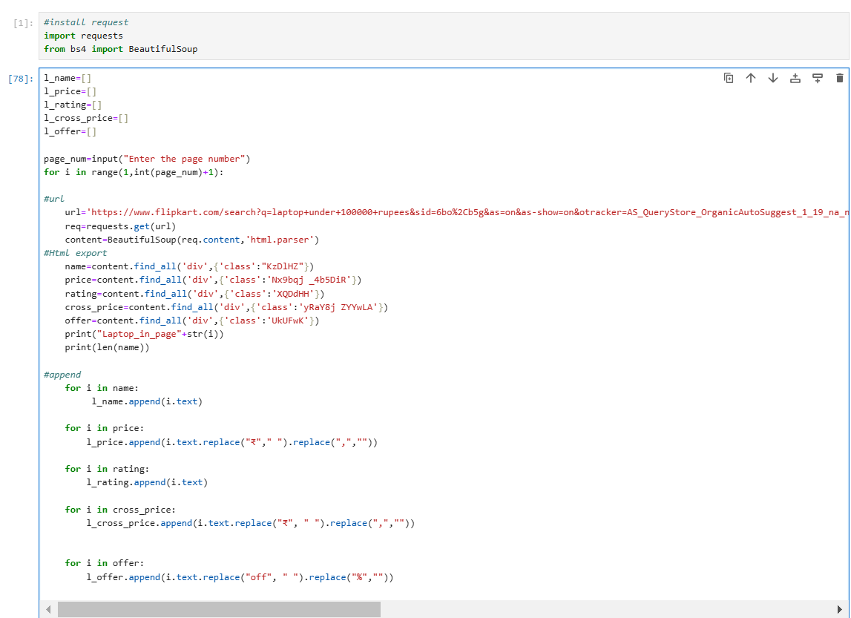
CODING

Slide 6
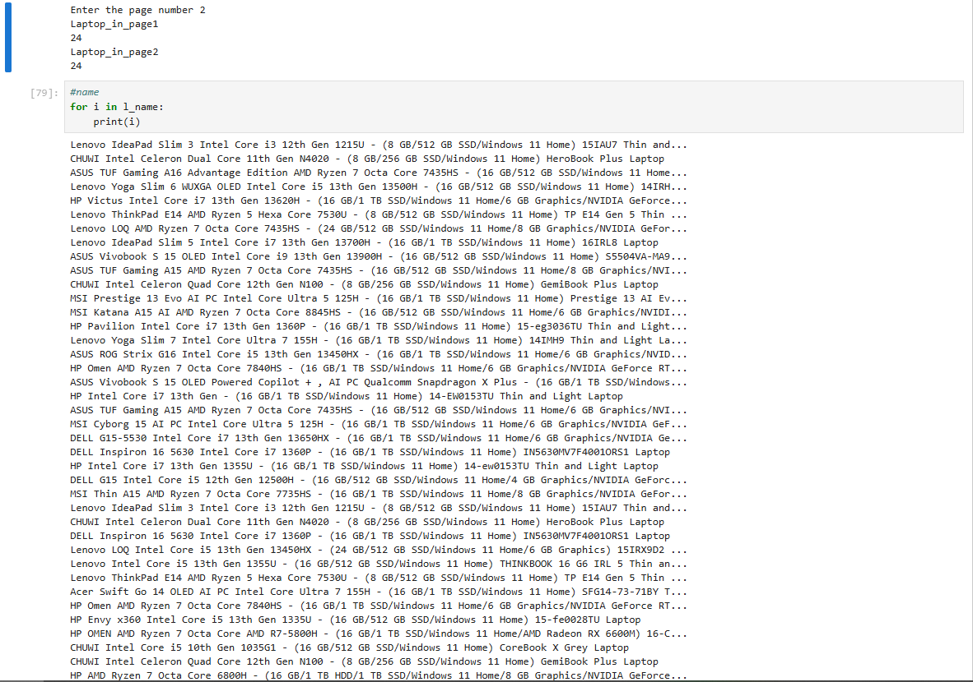

Slide 7
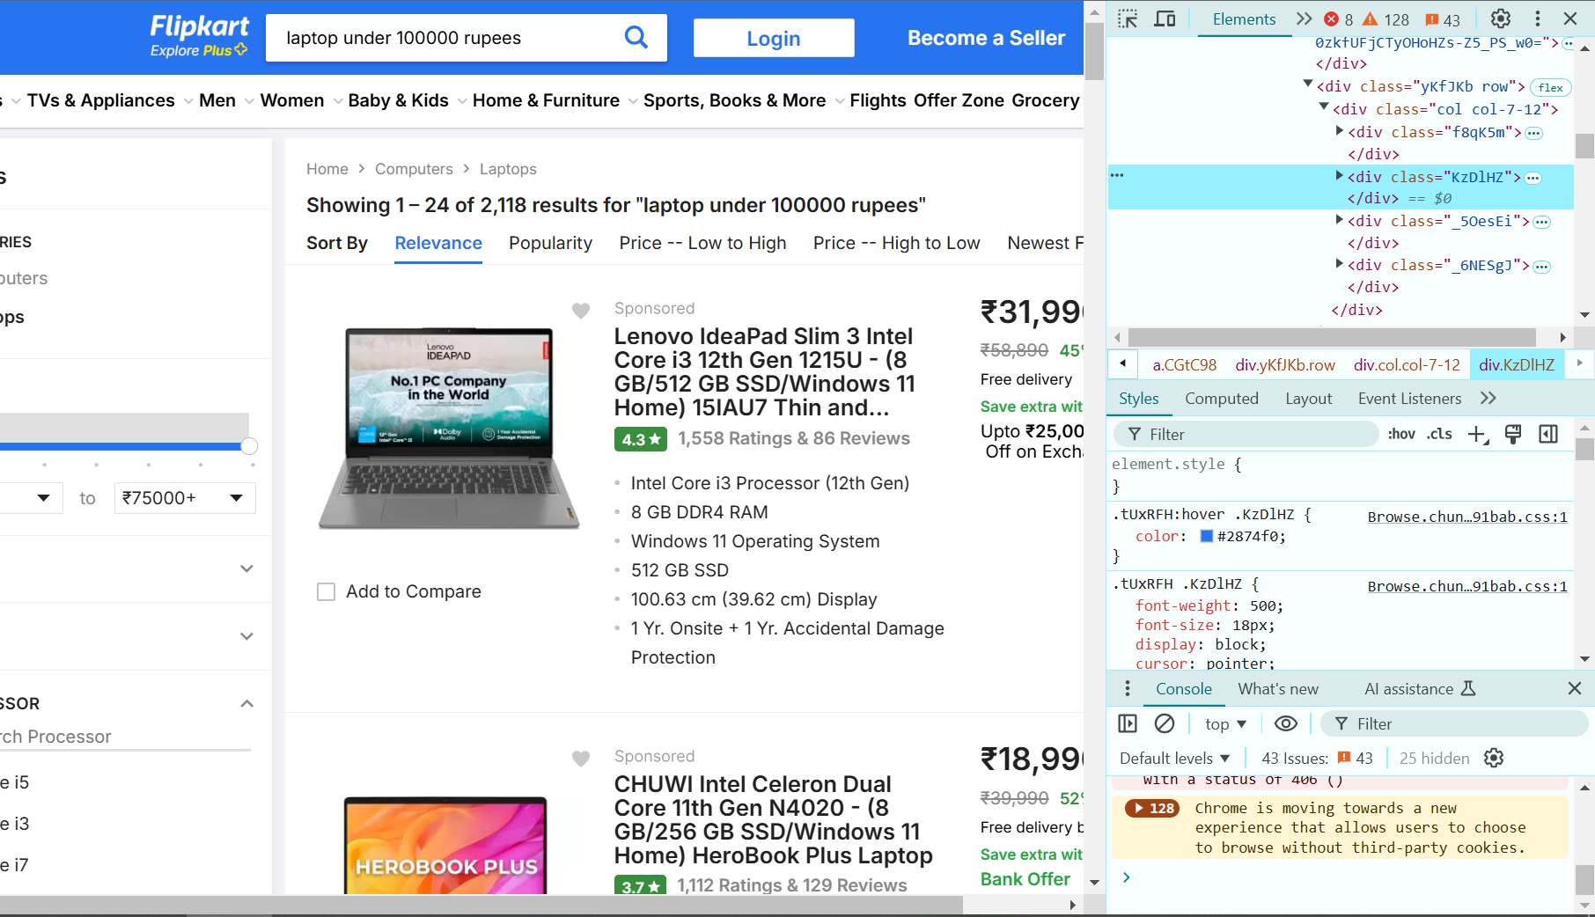

Slide 8
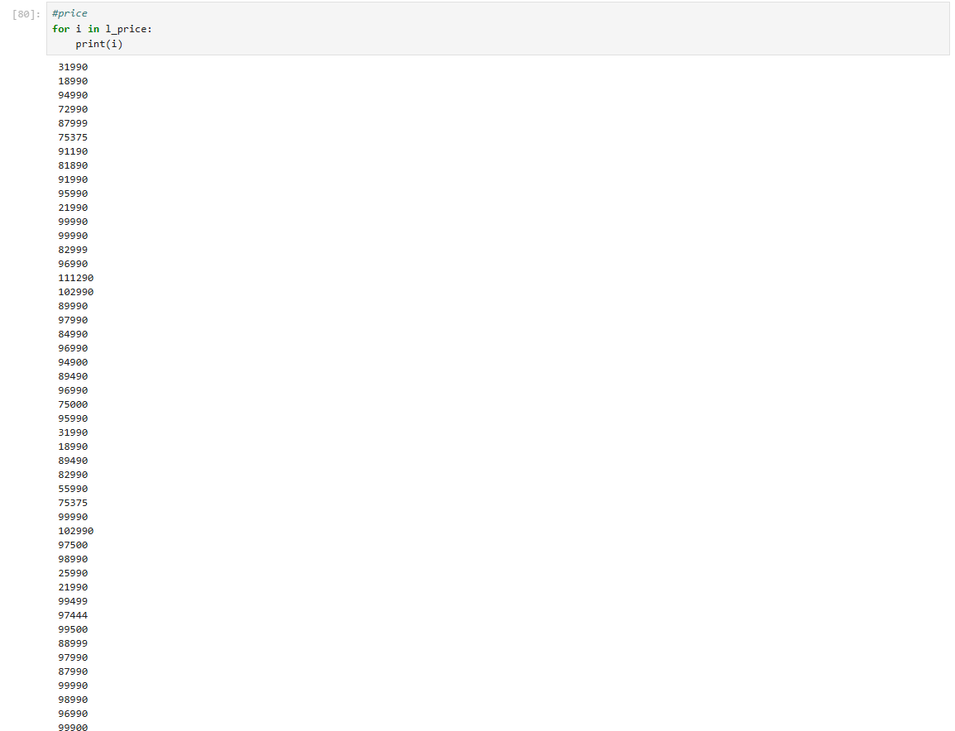

Slide 9
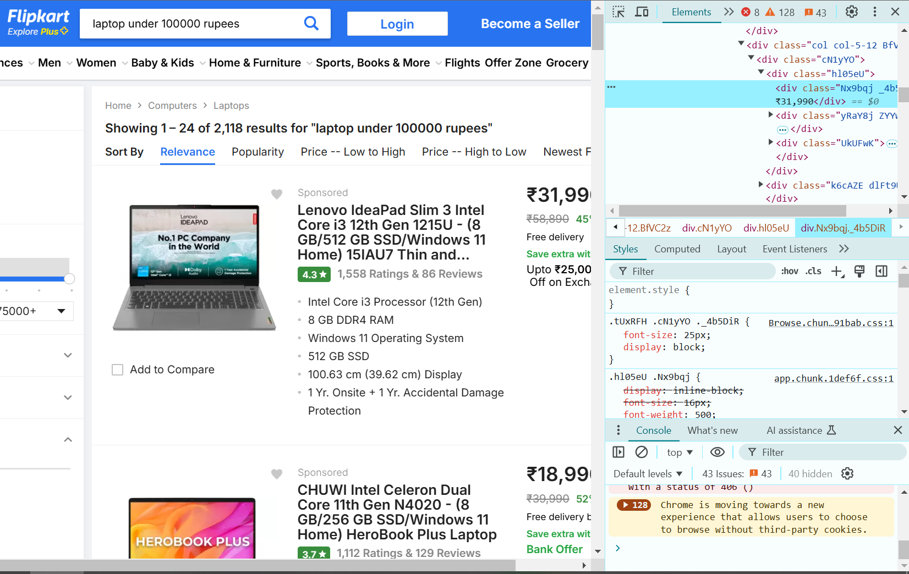

Slide 10
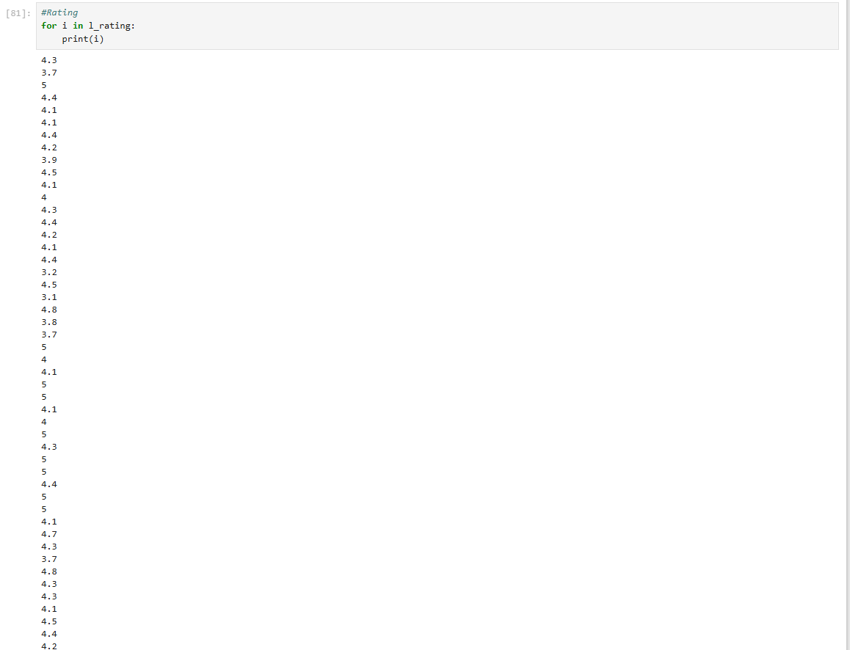

Slide 11
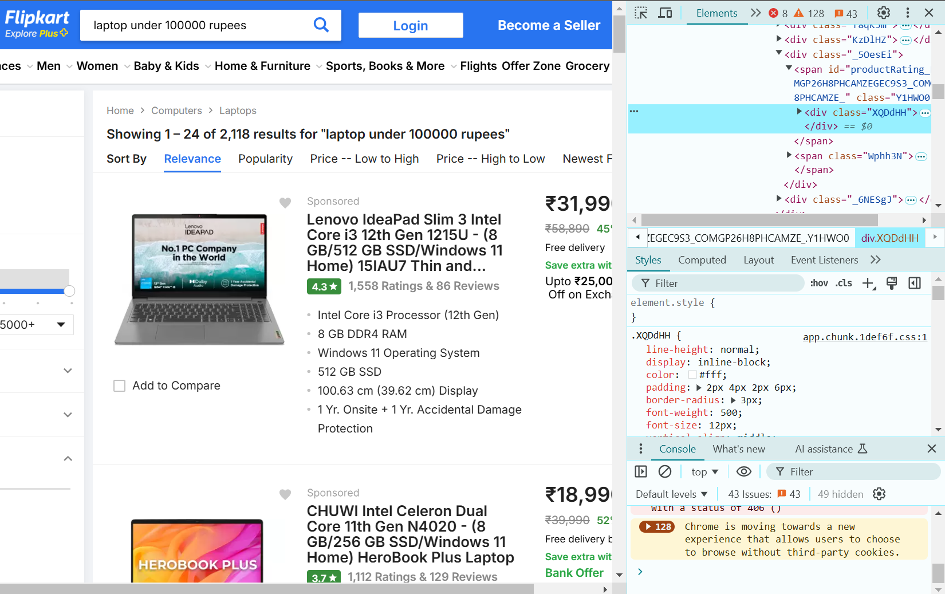

Slide 12
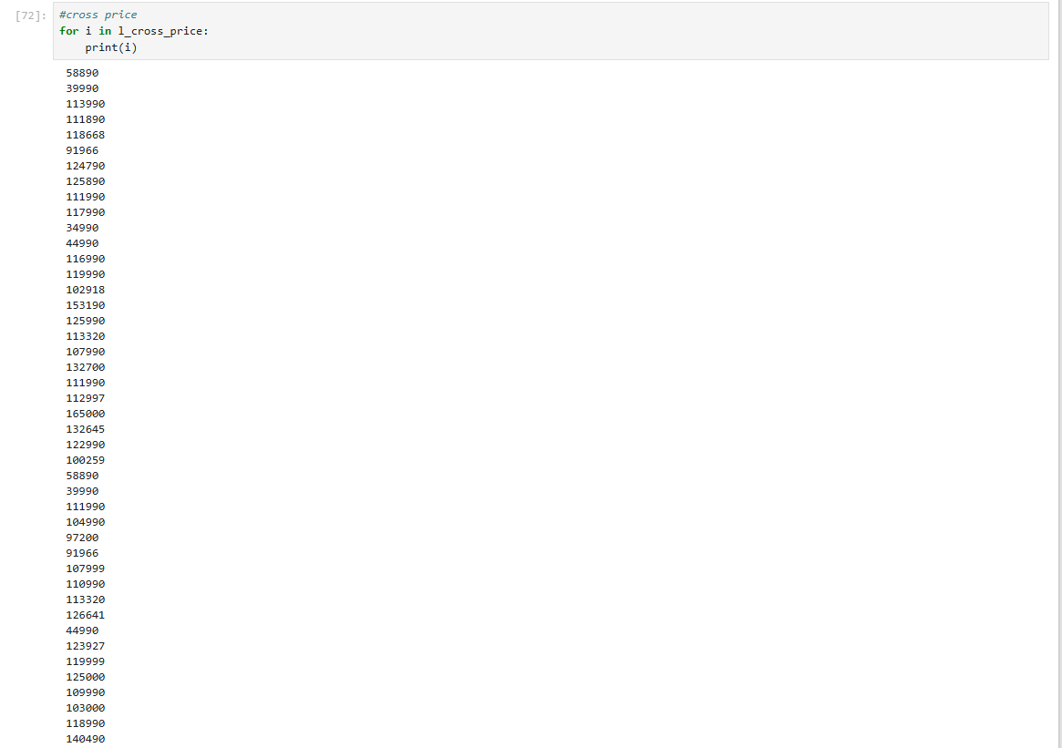

Slide 13
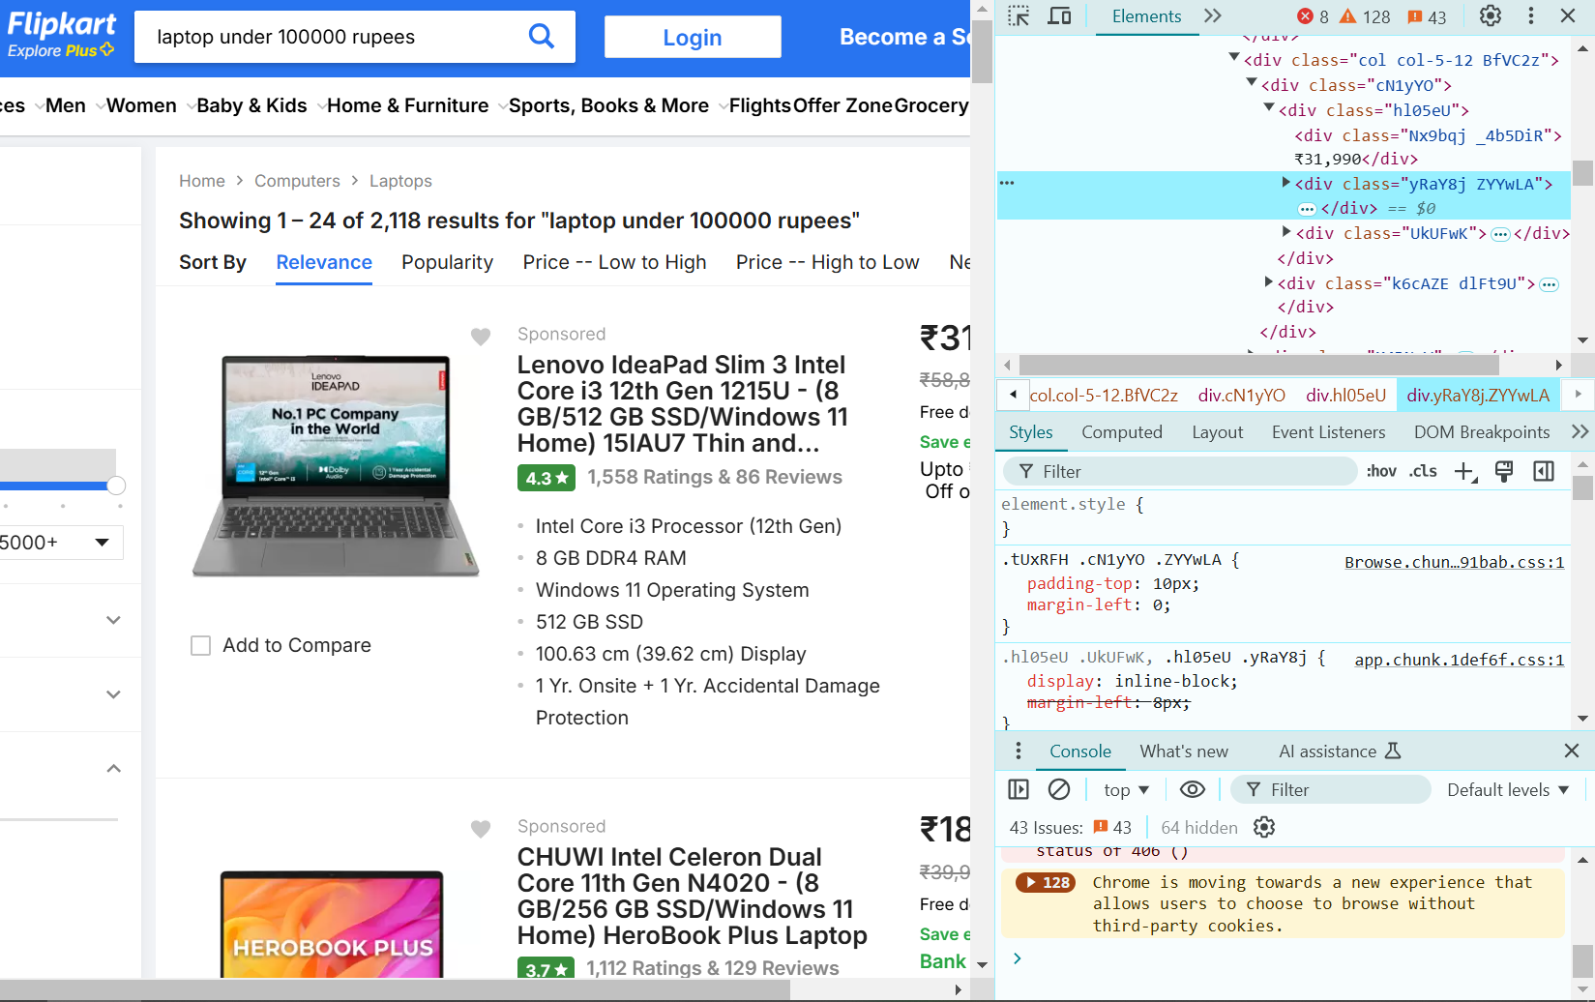

Slide 14
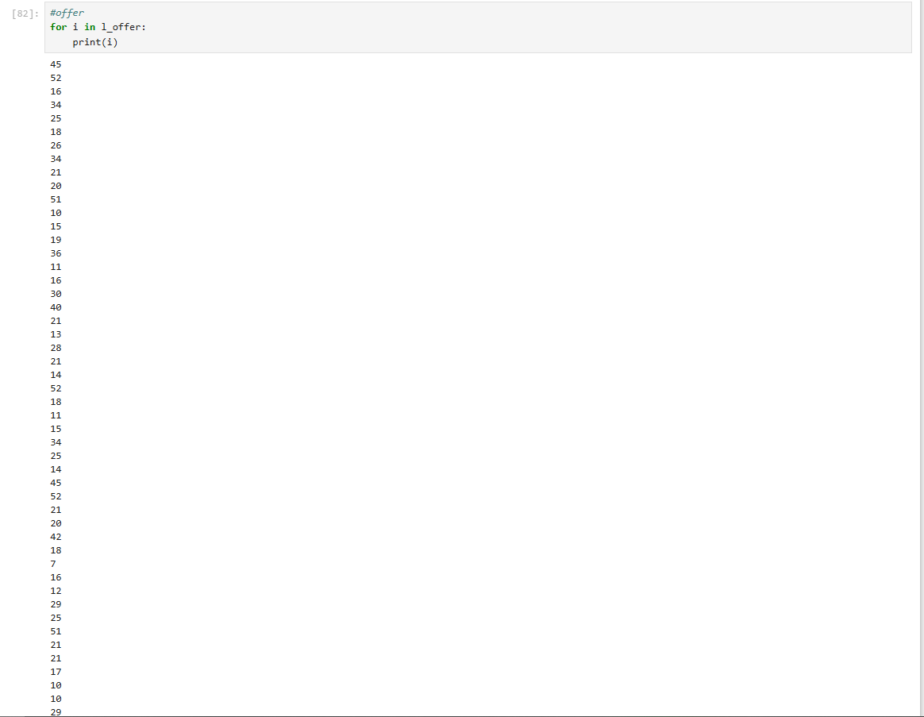

Slide 15
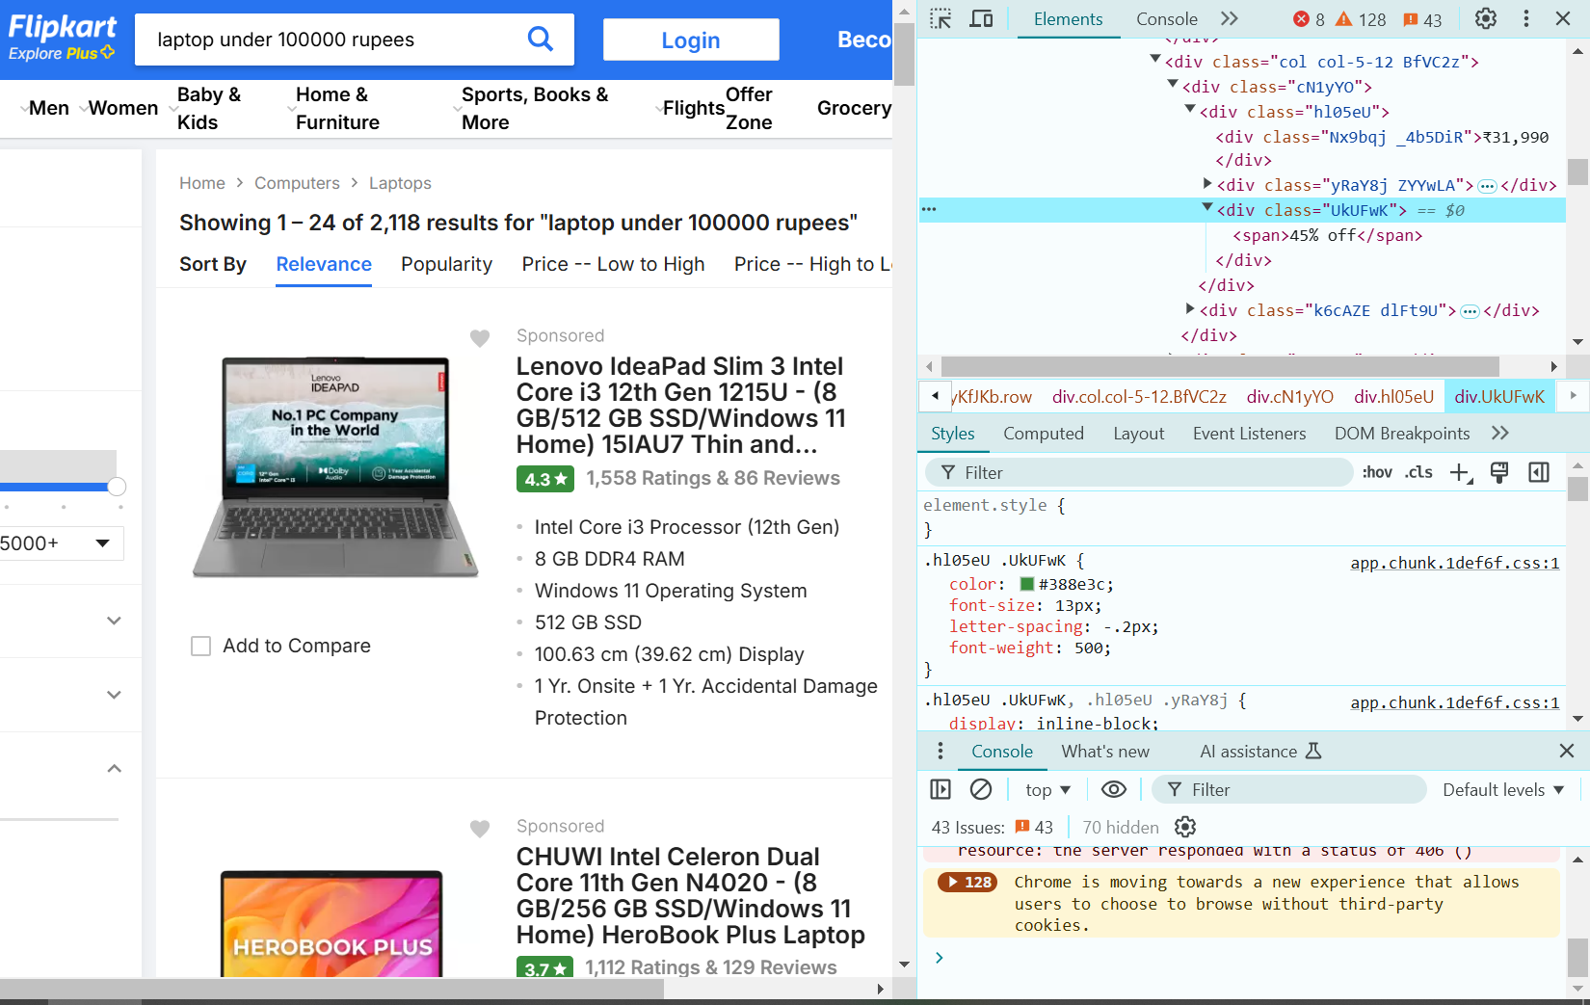

Slide 16
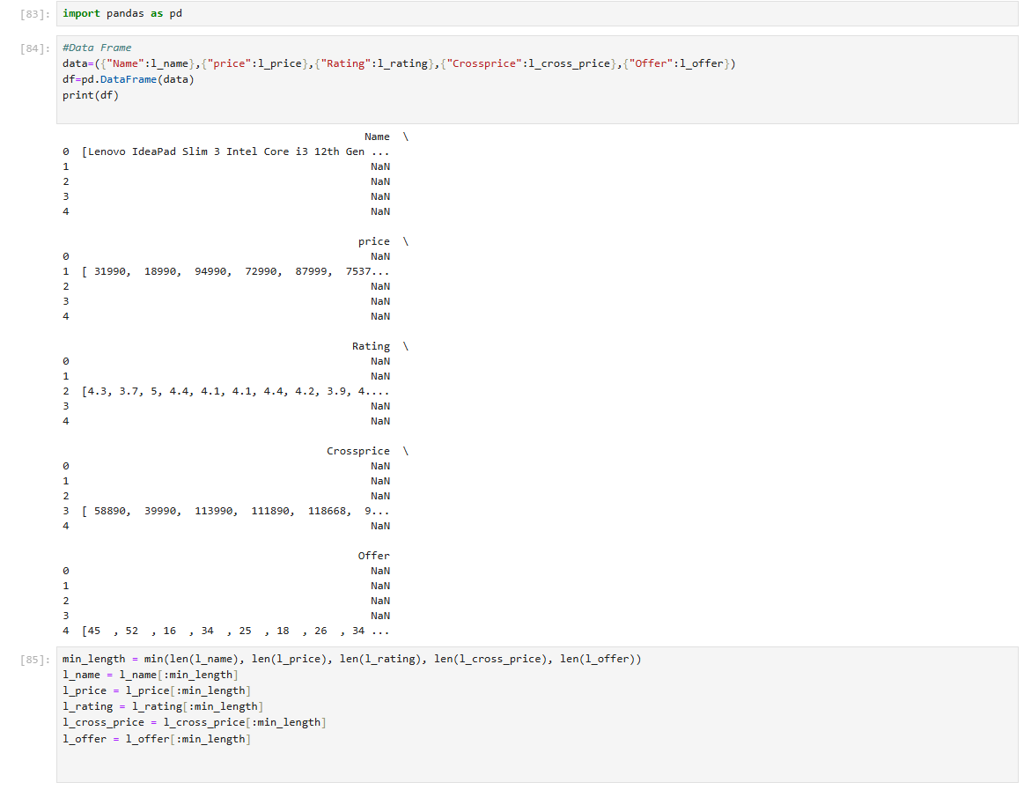

Slide 17
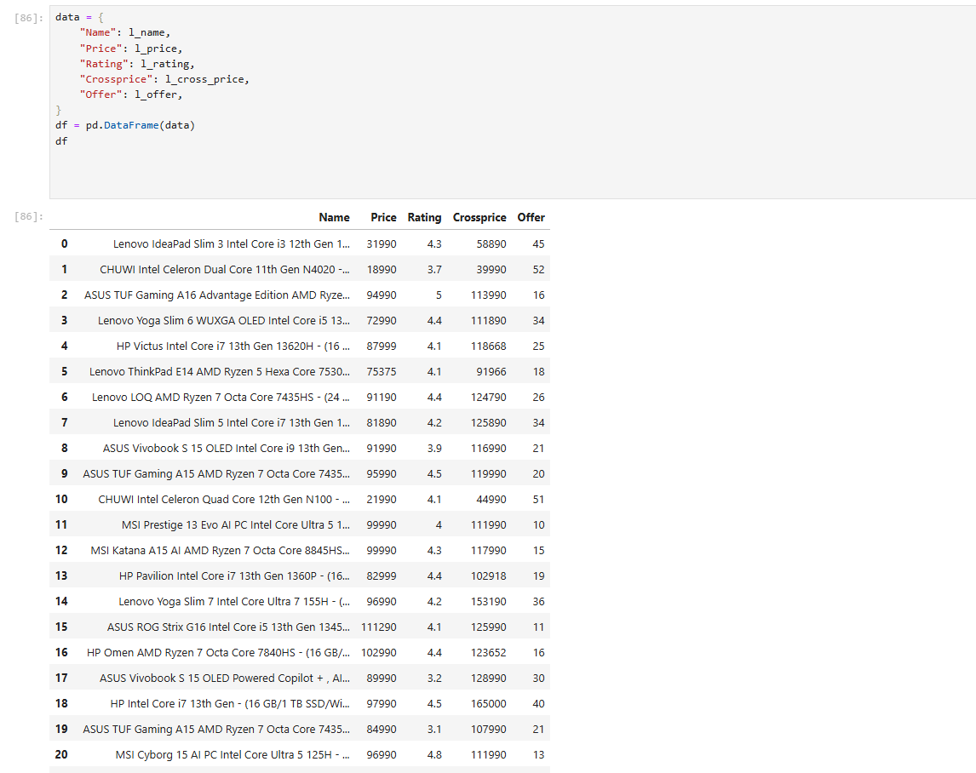

Slide 18
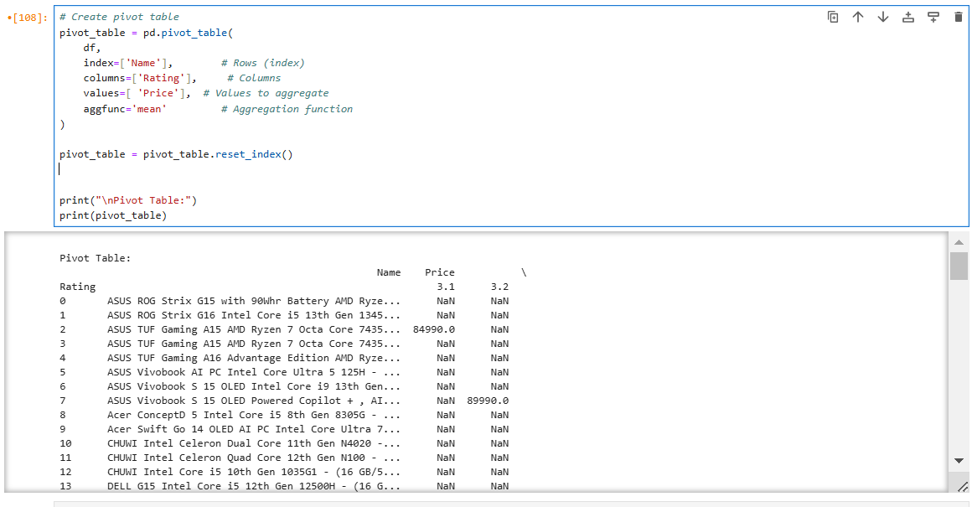
PIVOT TABLE

Slide 19
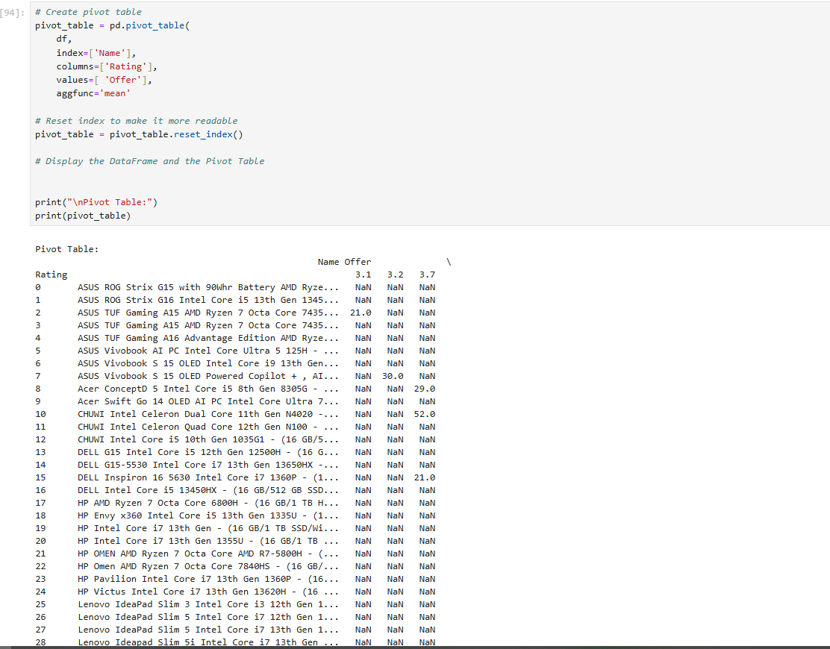

Slide 20
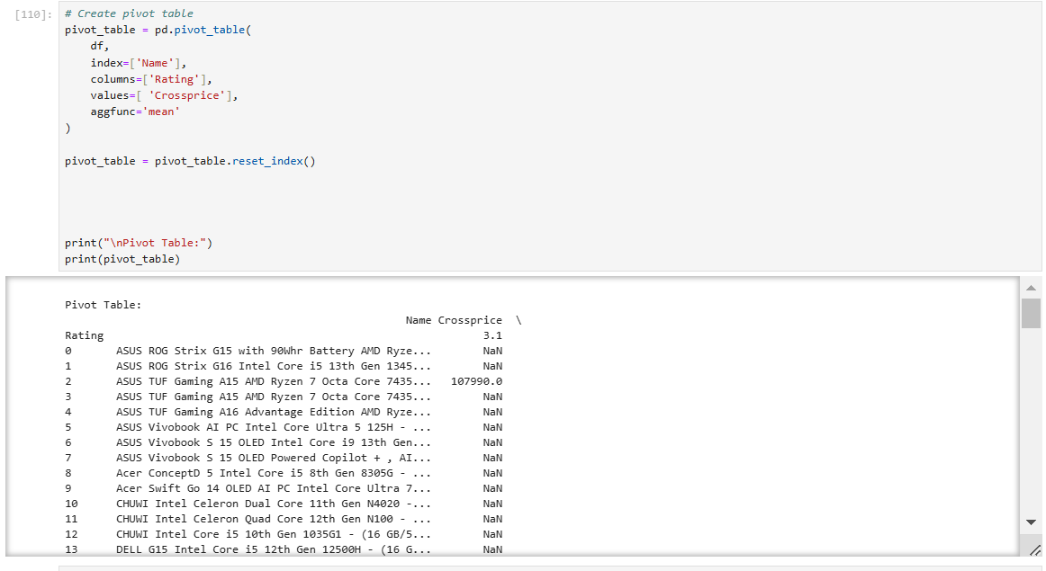

Slide 21
RESULT
This analysis taught me how to gather insights from unstructured web data effectively.
This data can be used to analyse the price trends,rating and customer preference.

Slide 22


